Slide 1
Eigen… do we need this?

Slide 3
Eigen… do we need this?

Slide 4
Yes

Slide 5
Eigenvectors and eigenvalues are the foundations of ordination

Slide 6
Principal component analysis: a review
PC1
Maximum temperature
PC2
PC2
Minimum temperature
PC1

Slide 7
Principal component analysis: screeplot
PC1
Maximum temperature
Variance explained
PC2
Minimum temperature
PC1
PC2
87.5%
12.5%
Notes:
Briefly introduce variance explained and scree plots

Slide 8
Principal component analysis: loadings
PC1
 | PC1 | PC2
Maximum temperature | 0.707 | -0.707
Minimum temperature | 0.707 | 0.707
Maximum temperature
PC2
Minimum temperature
Notes:
Talk about loadings and what they mean

Slide 9
Principal component analysis: a review
PCA axes are orthogonal
PCA axes are ordered by decreasing variance explained
No rules about cut offs for important axes or loadings
Useful in linear models
PC1 may not be the most important axis for your data

Slide 10
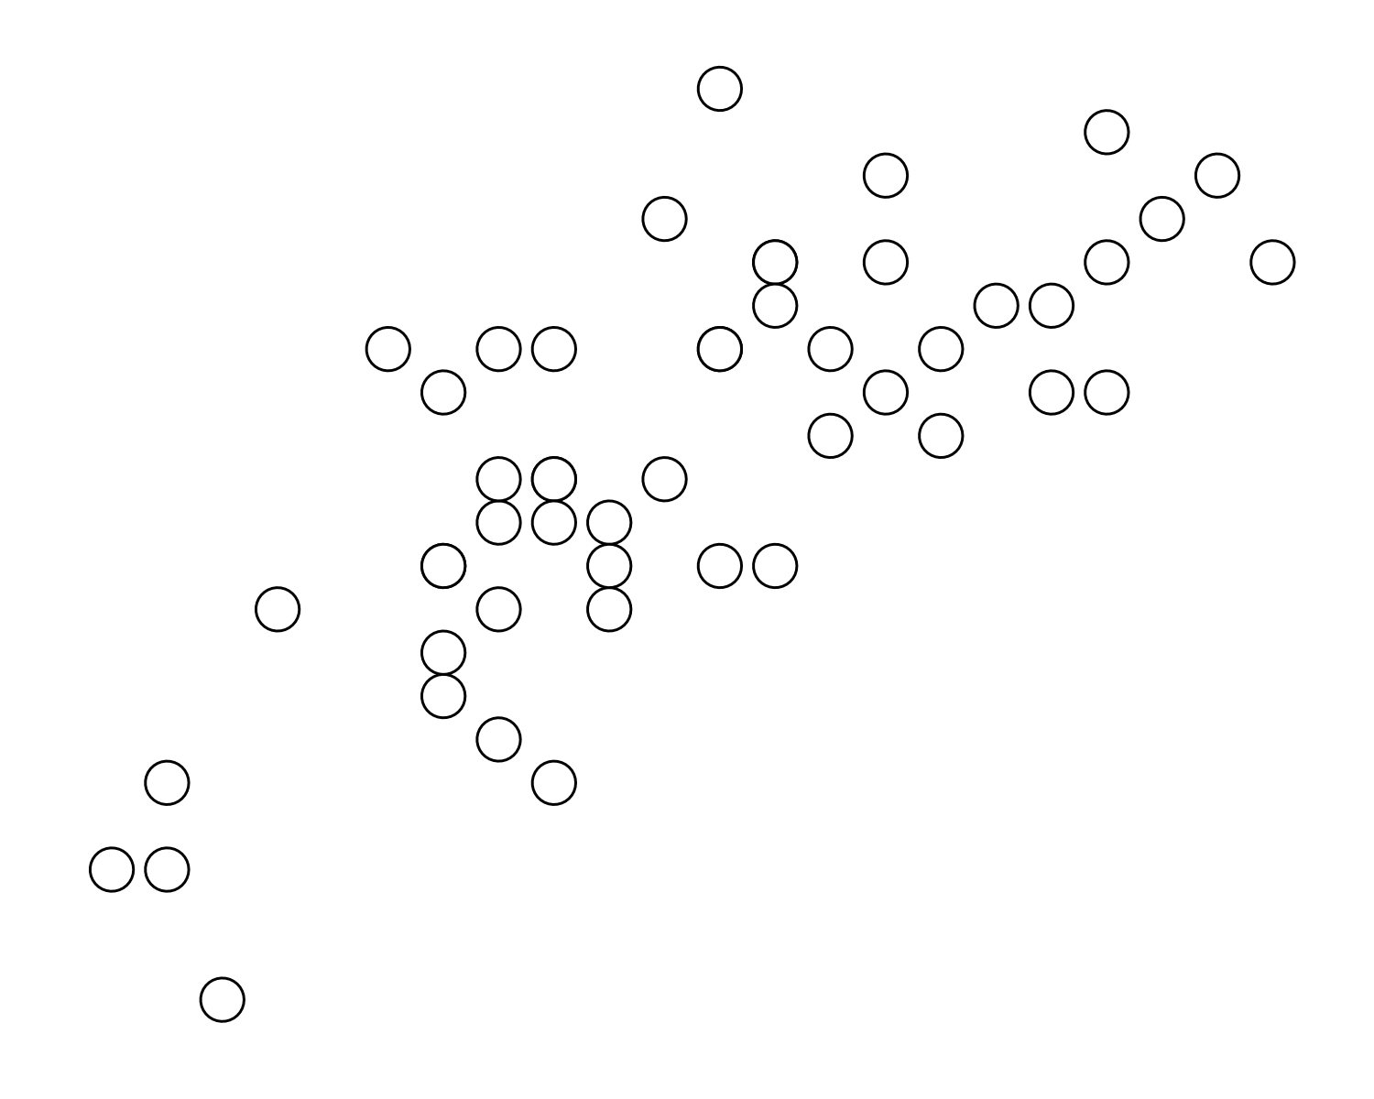
Notes:
Take your stats caps off for a second. Eigenvectors and eigen values are concepts taken from linear algebra.

Slide 11
Some linear algebra: scaling
$$\left[\frac{2}{1}\right]$$
$$\left[\frac{4}{2}\right]$$
5
$$\left[\frac{x}{y}\right]$$
$$∙2=$$
4
$$\frac{\left(2 × 2\right)}{(1 × 2)} =\left[\frac{4}{2}\right]$$
3
2
1
0
0
1
2
3
4
5
Notes:
Scaling (in linear algebra) changes the length of lines

Slide 12
Some linear algebra: linear transformations
5
$$\left[\frac{2}{1}\right]$$
$$\left[\frac{4}{2}\right]$$
5
$$\left[\frac{2}{1}\right]$$
$$∙ \left[\begin{matrix}1 & 1 \\ 0 & 1\end{matrix}\right] =$$
$$\left[\frac{3}{1}\right]$$
$$∙2=$$
4
4
$$\frac{\left(2 × 2\right)}{(1 × 2)} =\left[\frac{4}{2}\right]$$
$$\frac{\left(2 × 1\right)+\left(1 × 1\right)}{\left(1 × 0\right)+(1 × 1)} =\left[\frac{3}{1}\right]$$
3
3
2
2
1
1
0
0
0
1
2
3
4
5
0
1
2
3
4
5
Notes:
Linear transformations MOVE lines

Slide 13
Some linear algebra: linear transformations
5
$$\left[\begin{matrix}0 & −1 \\ 1 & 0\end{matrix}\right]$$
5
$$\left[\begin{matrix}1 & 1 \\ 0 & 1\end{matrix}\right]$$
2.5
2.5
0
0
-2.5
-2.5
-5
-5
-5
-2.5
0
2.5
5
-5
-2.5
0
2.5
5
Notes:
Linear transformations can be applied to many lines

Slide 14
Some linear algebra: linear transformations
[0, 0]
[-2, 2]
Notes:
Or even to entire grids

Slide 15
Some linear algebra: linear transformations
Notes:
Or even to entire grids

Slide 16
Some linear algebra: linear transformations
5
$$\left[\begin{matrix}0 & −1 \\ 1 & 0\end{matrix}\right]$$
5
$$\left[\begin{matrix}1 & 1 \\ 0 & 1\end{matrix}\right]$$
2.5
2.5
0
0
-2.5
-2.5
-5
-5
-5
-2.5
0
2.5
5
-5
-2.5
0
2.5
5

Slide 17
Eigenvector!
Eigenvector: axis of movement
Eigenvalue: amount of movement
Notes:
You can imagine a matrix like a gust of wind, an invisible force that produces a visible result. And a gust of wind must blow in a certain direction. The eigenvector tells you the direction the matrix is blowing in

Slide 18
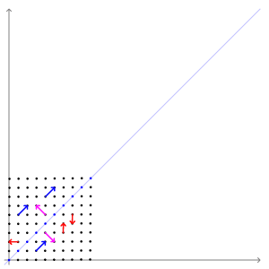
So what does this have to do with PCA?
While the examples above apply to lines, there is no differences between a line and a point in the math.
Eigenvectors and eigenvalues become very useful when needing to describe areas of greatest movement (or variance).

Slide 19
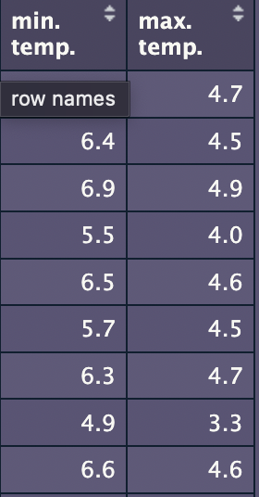
Principal component analysis: under the hood
Maximum temperature
Minimum temperature

Slide 20
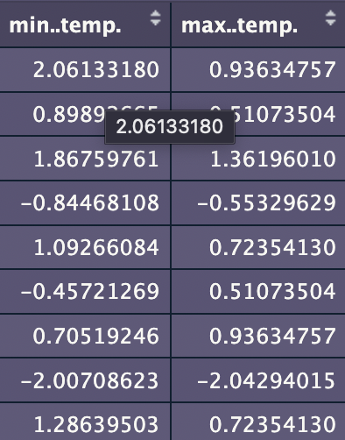
Principal component analysis: center & scale
Center
Maximum temperature
Minimum temperature
Scale

Slide 21
Principal component analysis: var/cov
$$\left[\begin{matrix}σ^{2}(y_{1}) & σ(y_{1},y_{2}) \\ σ (y_{2},y_{1}) & σ^{2}(y_{2})\end{matrix}\right]$$
Minimum temperature

Slide 22
Principal component analysis: var/cov
$$\left[\begin{matrix}1 & 0.75 \\ 0.75 & 1\end{matrix}\right]$$
Minimum temperature

Slide 23
Does this look familiar?
5
$$\left[\begin{matrix}1 & 1 \\ 0 & 1\end{matrix}\right]$$
$$\left[\begin{matrix}1 & 0.75 \\ 0.75 & 1\end{matrix}\right]$$
0
-5
-5
-2.5
0
2.5
5

Slide 24
Does this look familiar?
Movement
Variance
$$\left[\begin{matrix}1 & 1 \\ 0 & 1\end{matrix}\right]$$
$$\left[\begin{matrix}1 & 0.75 \\ 0.75 & 1\end{matrix}\right]$$
Eigenvector:
Axis of movement
Eigenvalue:
Magnitude of movement
Eigenvector:
Axis of variance
Eigenvalue:
Magnitude of variance

Slide 25
Principal component analysis: eigen!
Eigenvectors:
[0.707, 0.707]
[0.707, -0.707]
Eigenvalues
1.75
0.25
$$\left[\begin{matrix}1 & 0.75 \\ 0.75 & 1\end{matrix}\right]$$

Slide 26
Principal component analysis: plot
PC1 [0.707, 0.707]
Eigenvectors:
[0.707, 0.707]
[0.707, -0.707]
Eigenvalues
1.75
0.25
Maximum temperature
PC2 [0.707, -0.707]
Minimum temperature

Slide 27
Principal component analysis: screeplot
Eigenvectors:
[0.707, 0.707]
[0.707, -0.707]
Eigenvalues
1.75
0.25
Total: 2
Variance explained
1.75
0.25
PC1
PC2
87.5%
12.5%

Slide 28
R

